Slide 1



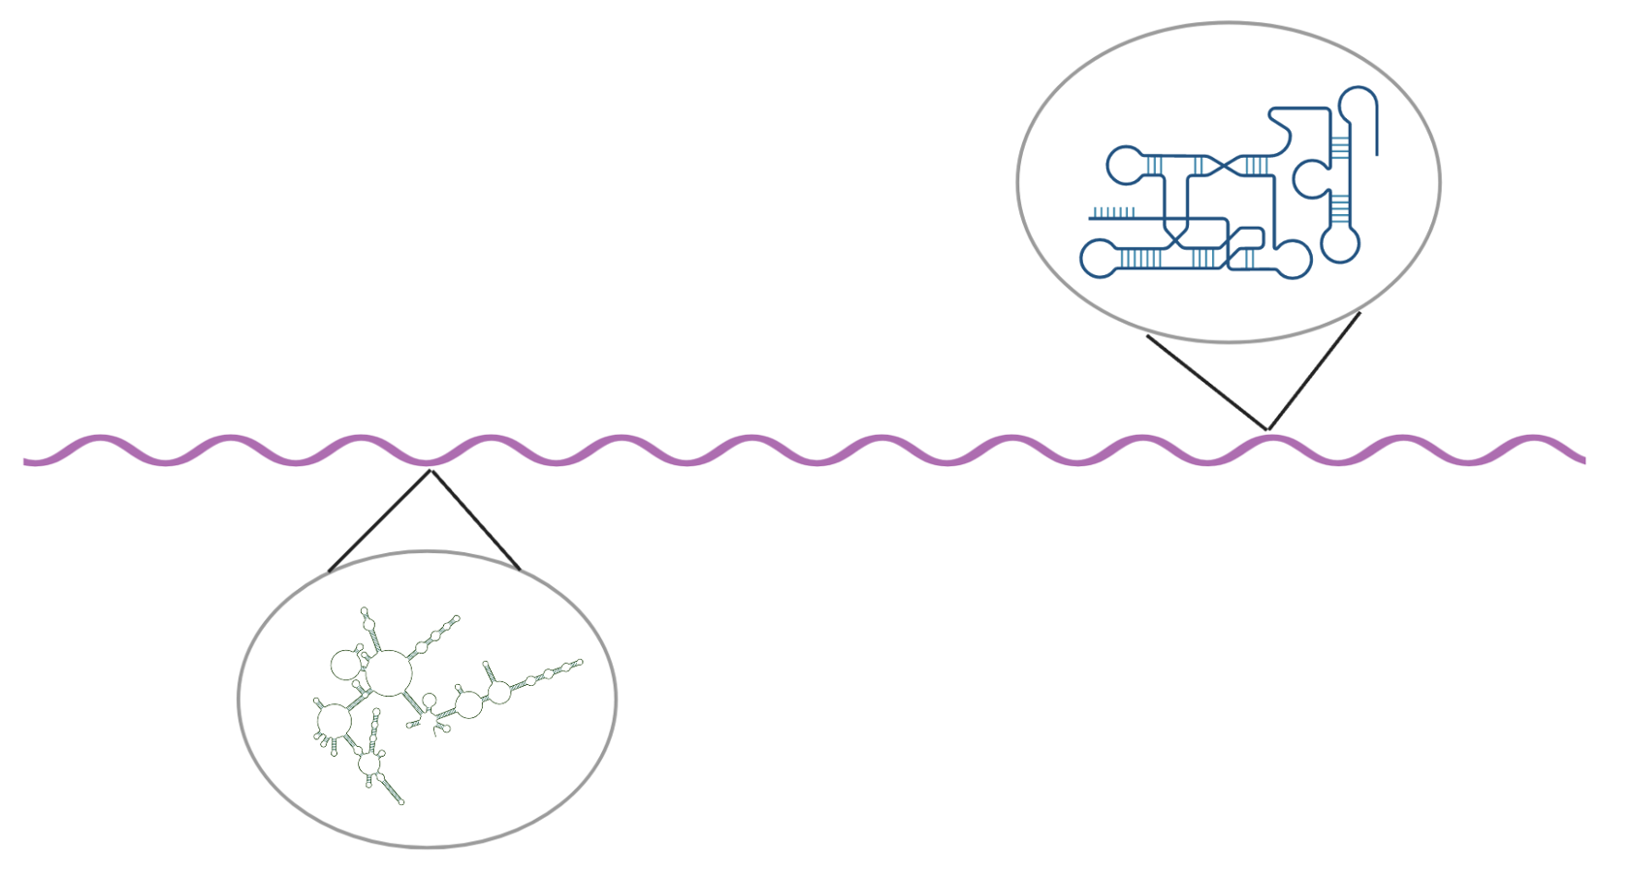
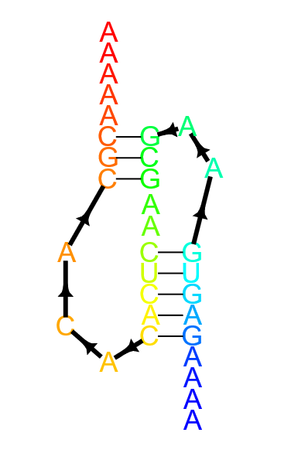
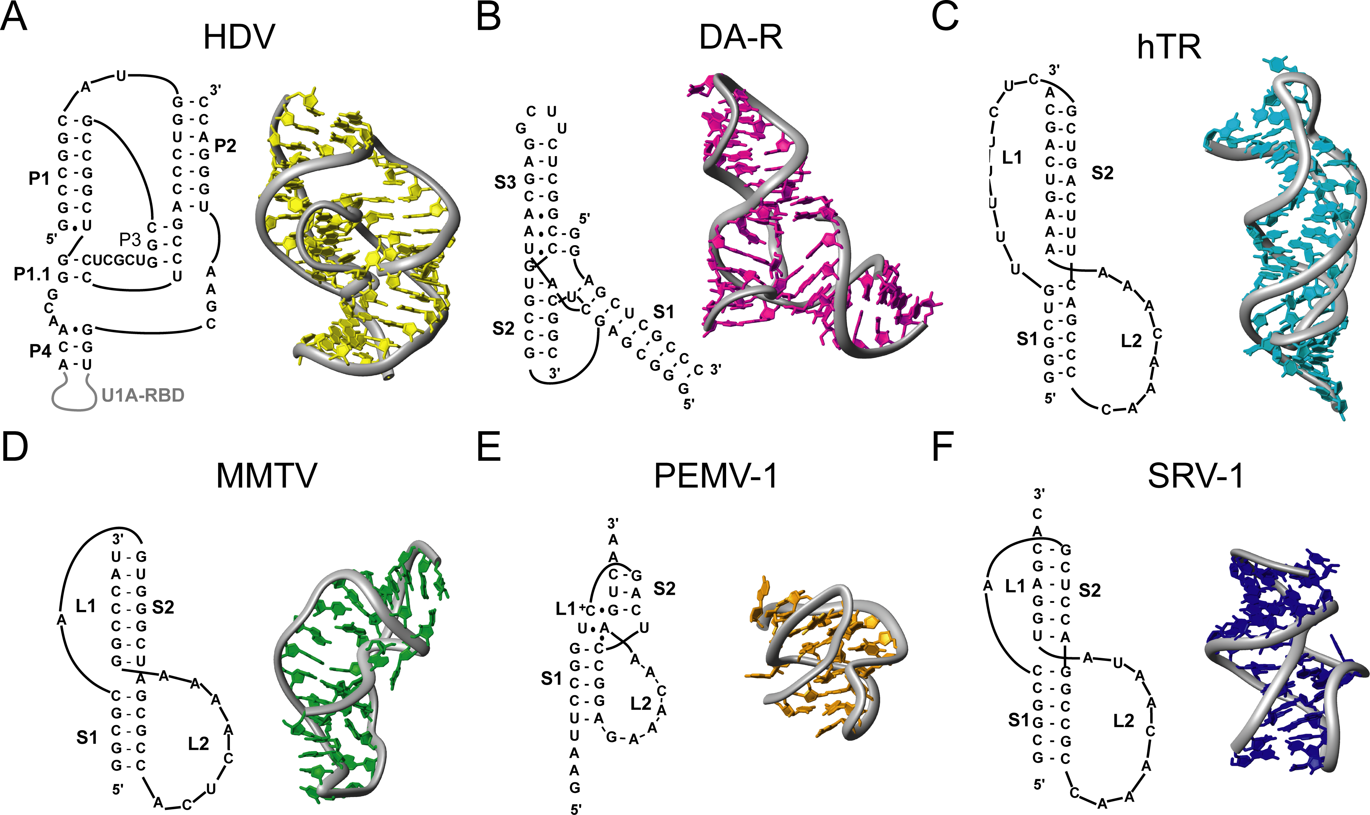
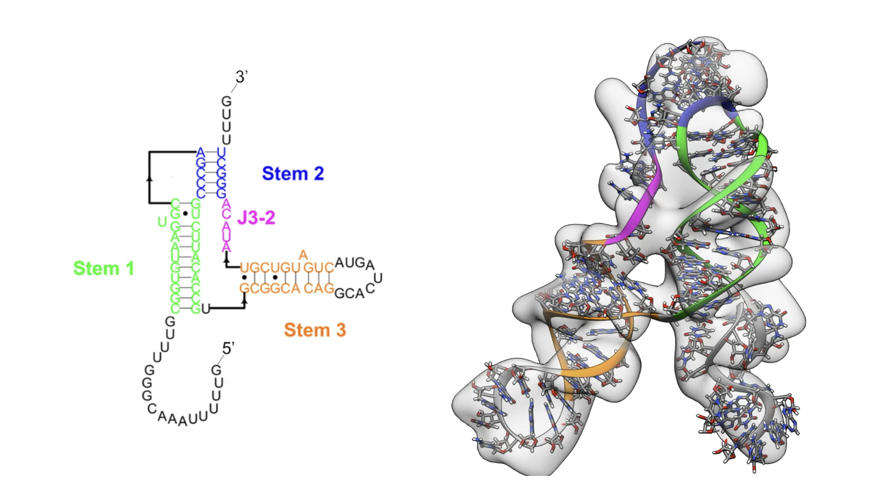
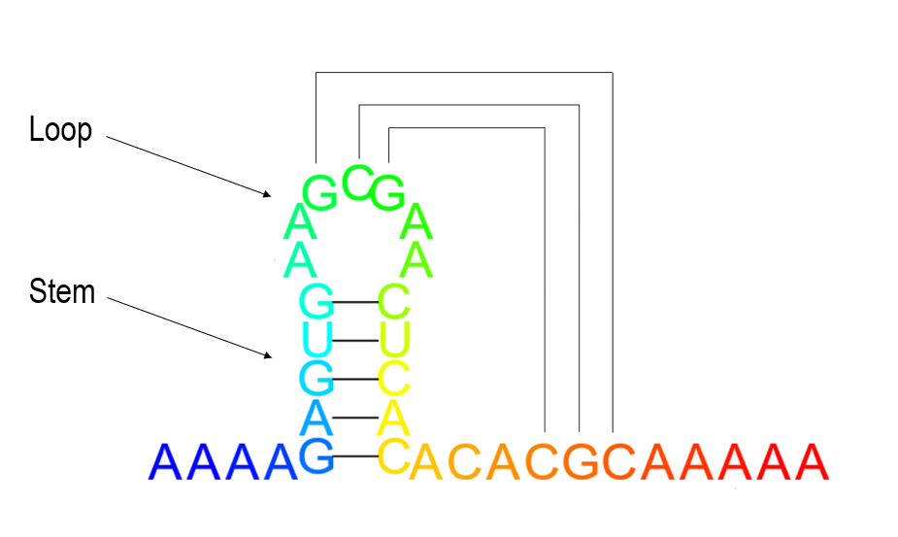
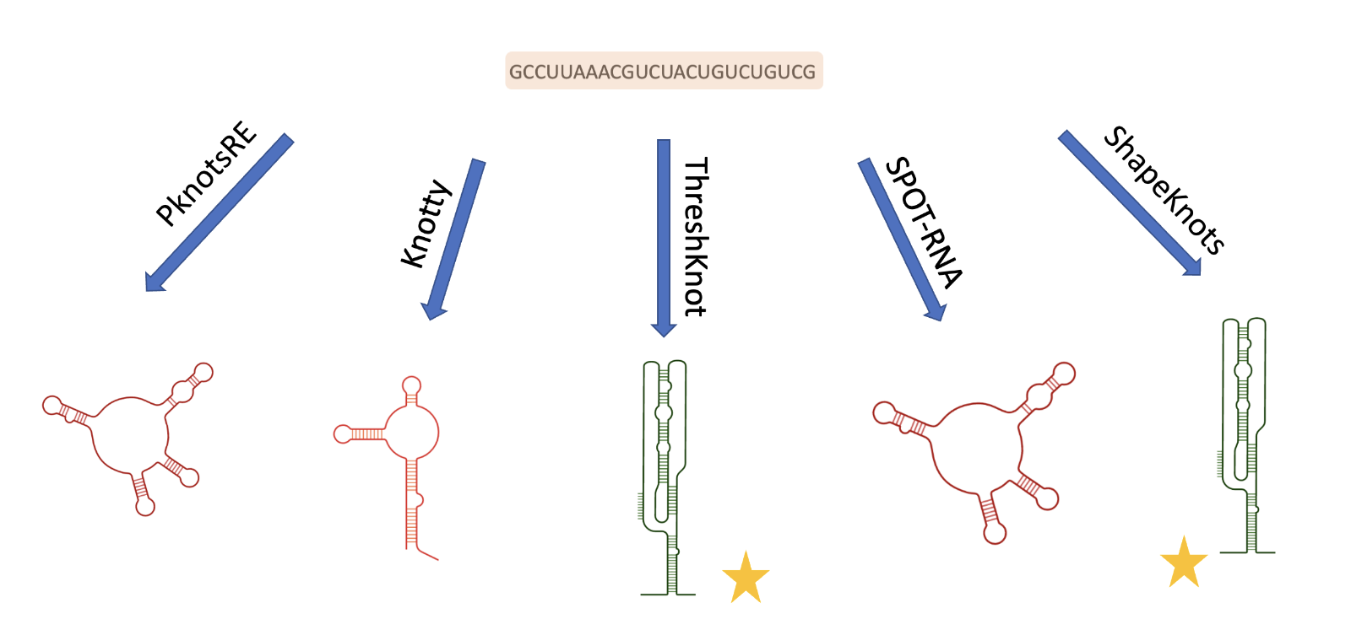
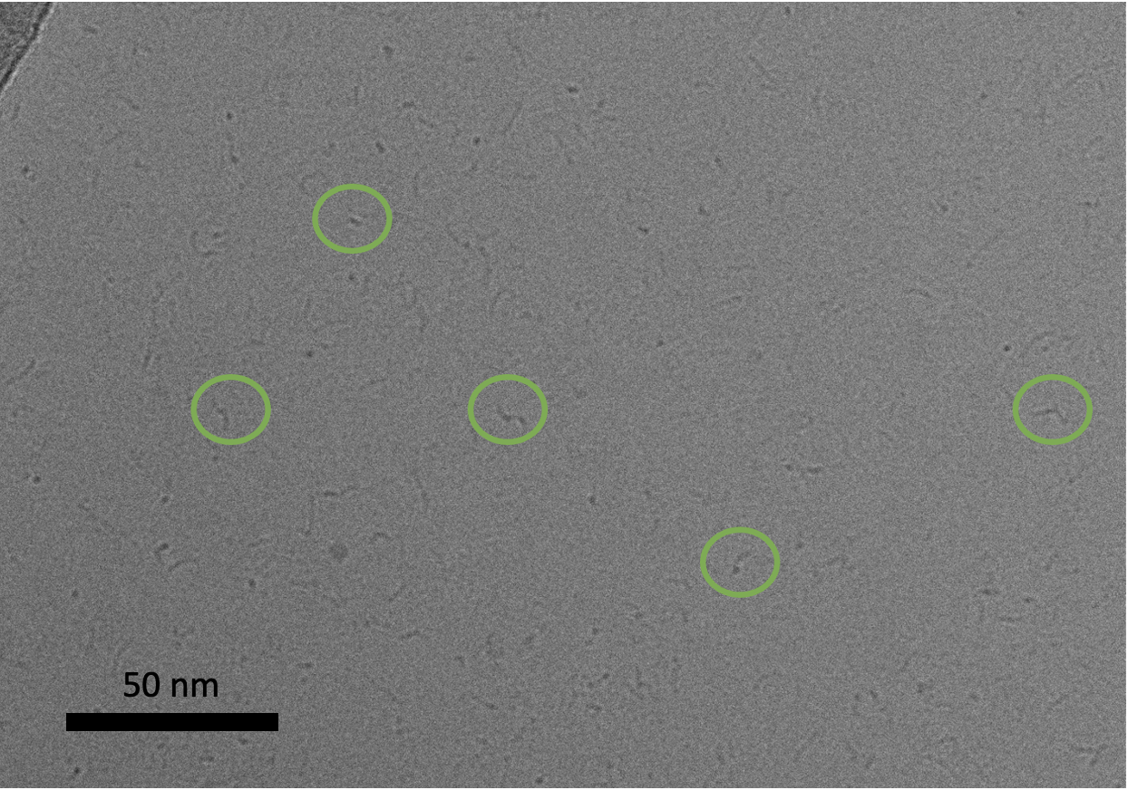

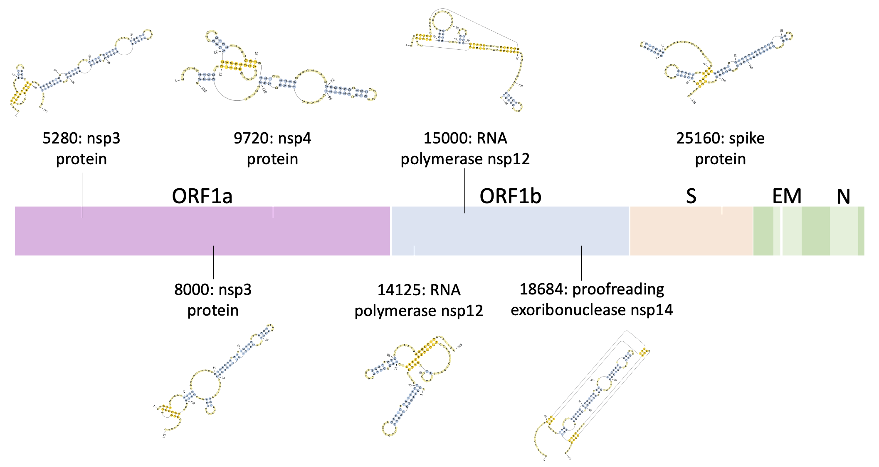
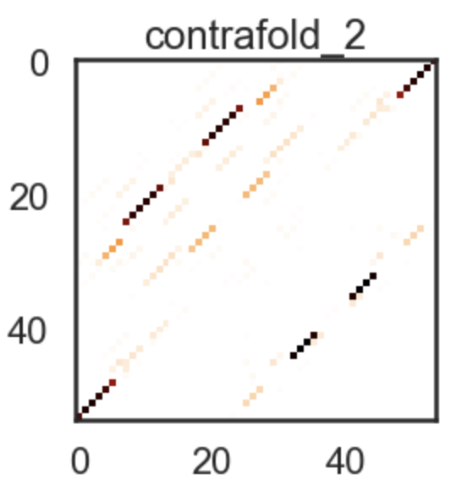
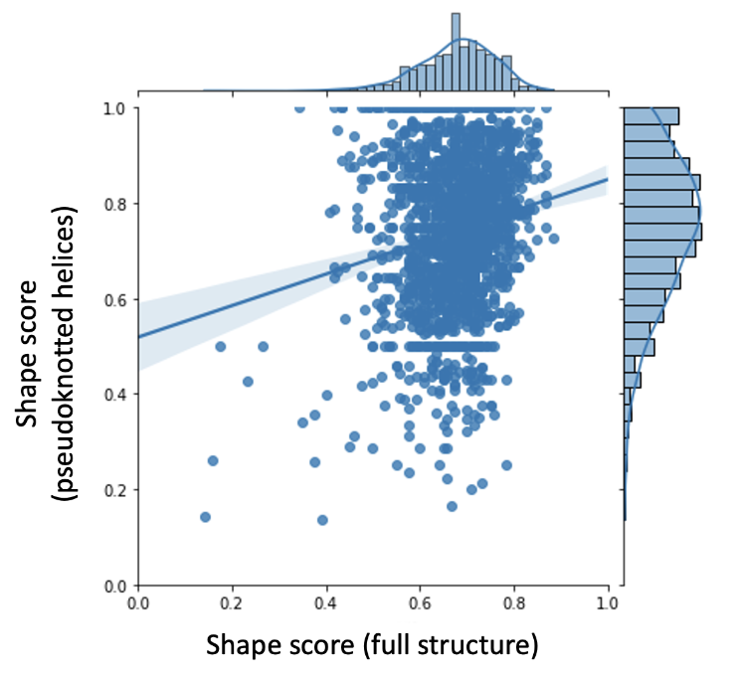
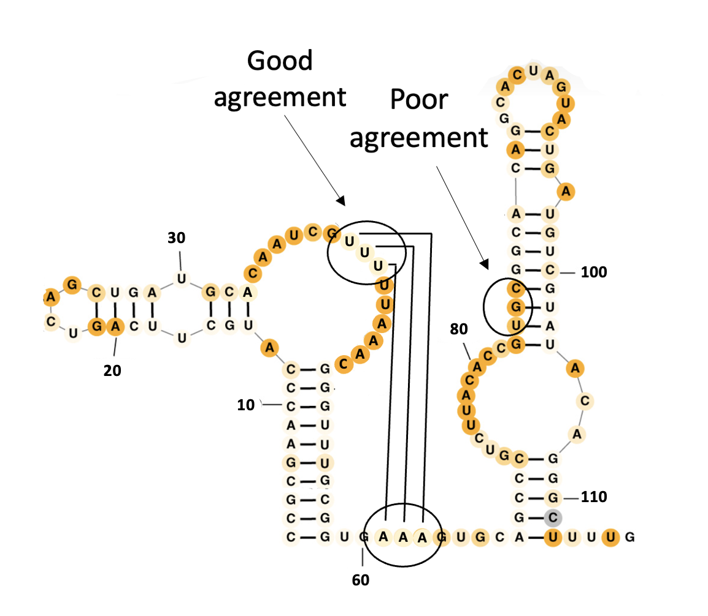
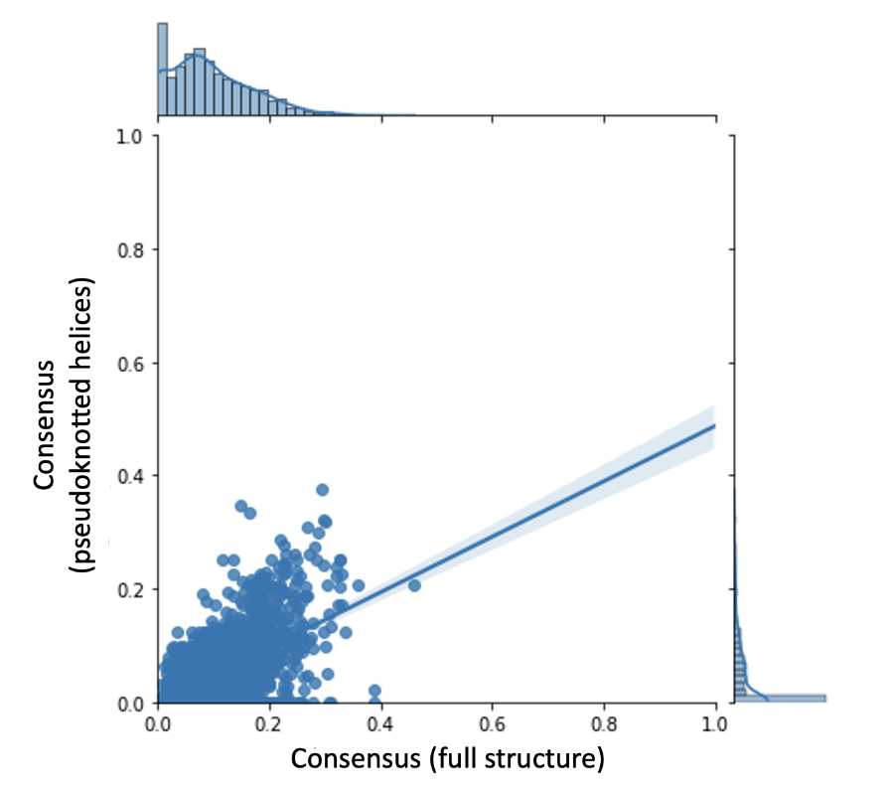
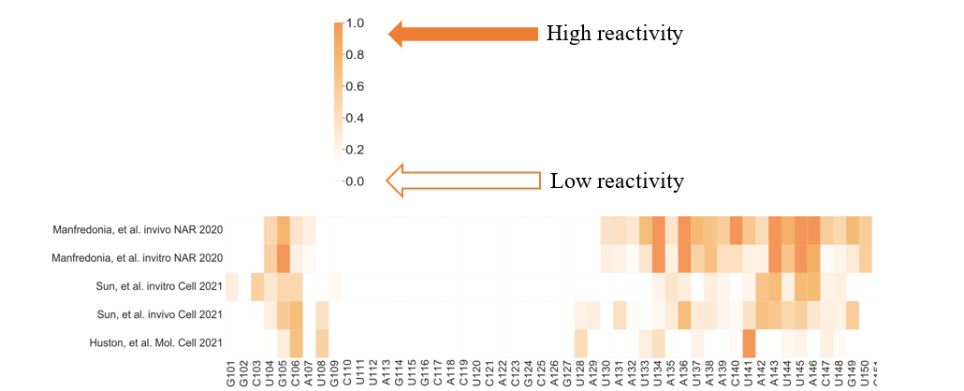
Identifying Pseudoknots in SARS-CoV-2 with ViralKnots
Grace Nye ¹, Rachael Kretsch², Rhiju Das^{1,2}
(1)Department of Biochemistry, Stanford University, (2)Biophysics Program,
Stanford University
Background
Introduction
Materials and Methods
Conclusions & Future Directions
Among all living things, RNA plays a variety of crucial roles such as catalysis, protein production, and gene regulation (1). Resolving the structures of these RNAs is critically important to understanding their functions and potential for therapeutic targeting. Pseudoknots (PKs), a type of secondary structure which creates unique 3-dimensional folds, can play fundamental roles in the viral life cycle, and as such, can be potential targets for small molecule antivirals. Here we report predictions for novel PKs within the SARS-CoV-2 genome.
RNA is capable of forming complex secondary structures, in which the bases fold over to pair with other bases on the same strand. Pseudoknots occur when bases inside a loop pair with bases outside the loop (1).
Predicting PKs is known to be very difficult computationally (2, 9). There are three major types of algorithms that can predict RNA secondary structures. The first uses existing thermodynamic parameters to calculate the structure with the minimum free energy (e.g. Pknots and Knotty). The second uses machine learning methods to predict structure (e.g. Contrafold2 and SPOT-RNA). However, these methods are limited by the lack of large training datasets for pseudoknotted structures.
Finally, experimentally collected SHAPE reactivity data can be used to guide secondary structure predictions using the algorithm ShapeKnots (3). Bases that are paired with other bases are more stable, and therefore less reactive.
By creating a library of known viral structures, our ability to respond to viral threats in the future may be greatly improved. RNA is the primary form of genetic material for many viruses, and therefore, understanding and being able to more accurately predict its 3D structure and interaction with the 3D environments within our bodies is vital to improving our ability to develop therapeutics capable of binding to the virus’s RNA without being harmful to humans. PKs are widespread and functionally important structures in both viruses and human genomes.
The ViralKnots pipeline takes the viral genome and SHAPE data as input and outputs a list of potential pseudoknots.
First, the genome is divided into overlapping windows. Then, five algorithms are run over each window to generate structure predictions. PKs are marked and saved. Structures are scored and ranked on 1) thermodynamic stability; 2) overall agreement with SHAPE reactivity data; and 3) consensus.
We are currently working to experimentally validate these predictions by resolving the three-dimensional structure of the RNA sequences via CryoEM single particle analysis. The Ribosolve pipeline, used to resolve the structure of the SARS-CoV-2 frameshift stimulating element (FSE) pseudoknot, models the secondary structure of an RNA sequence into the 3D electron density map constructed from CryoEM data, and this yields an atomic model of the structure of the molecule.
Figure 5. ViralKnots predicts locations of PKs in viral genomes.
Figure 1. RNA secondary structure can form stems and loops (left). The stems are helical structures, similar to the well-known double helix of DNA. Pseudoknotted structures (right) fold over and create a knotted structure, one of the fundamental units of three-dimensional structure in RNA molecules.
Figure 4. (A) HDV (1SJ3). (B) Diels-Alder ribozyme (DA-R) (1YLS). (C) Human telomerase (hTR) (1YMO). (D) Mouse mammary tumor virus (MMTV) (1RNK). (E) Pea enation mosaic virus RNA1 (PEMV-1) (1KPZ). (F) Simian retrovirus 1 (SRV-1) (1E95).
Figure 9. 3D structure of SARS-CoV-2 FSE PK, resolved by modeling secondary structure into 3D electron density map from CryoEM.
Figure 6. ViralKnots pipeline divides genome into overlapping windows and runs PK predictors over each window. Starred structures are PKs.
Results
ThreshKnot
Figure 10. Micrograph of folded RNA (15000 PK).
Acknowledgements
I would like to acknowledge all those who have provided me with this opportunity and given invaluable feedback and assistance.
Figure 2. Example base pairing probability matrix used to generate PK prediction. The ThreshKnot heuristic generates prediction for two base pairs most likely to pair with one another.
Rhiju Das, PhD
Rachael Kretsch, PhD Candidate
S2C2
All other Das lab members
Isabel Delwel, PhD Candidate
Sherlock
Figure 7. Location and Structures of top ranked pseudoknots in SARS-CoV-2.
References
A
B
B
C
1. Brierley, I. et al. Nature Reviews Microbiology 2007, 5, 598-610.
2. Zhang, L., et al. Preprint. arXiv:1912.12796v2 [q-bio.BM], 2019.
3. Hajdin, C.E., et al. Proc. Natl. Acad. Sci. U.S.A. 2013, 110, 5498-5503.
4. Do, C.B., et al. Bioinformatics 2006, 22, e90-e98.
5. Zhang, H., et al. arXiv:1912.13190v3 [q-bio.BM], 2019.
6. Kappel, K., et al. Nature Methods 2020, 17, 699-707.
7. Rangan, R., et al. Nucleic Acids Res. 2021, 49, 3092-3108.
8. Bellaousov, S., et al. RNA 2010, 16, 1870-1880.
9. Singh, J., et al. Nat Commun 2019, 10, 1-13.
10. Zhang, K.; Zheludev, I. N., et al. Nat Struct Mol Biol 2021, 28, 747-754.
11. Zhang, J. Nature Methods 2022, 19, 1193-1207.
12. Jabbari, H. Bioinformatics 2018, 34, 3849-3856.
13. Rivas, E. Journal of Molecular Biology 1999, 285, 2053-68.
14. Staple, D.W. PLOS Biology 2005, 3(6), e213.
Figure 3. Example SHAPE reactivity heatmap. Experimental SHAPE data collected for SARS-CoV-2 can suggest whether a region of RNA is structured.
Figure 8. (A) Overall agreement of predictions with experimental SHAPE data, with 0 being no agreement and 1.0 being perfect agreement. (B) Example of pseudoknot with helices having both good agreement and poor agreement with experimental SHAPE data. (C) Consensus between predictors, where consensus is defined as base pairs in common divided by the length of the structure, with 0 being no agreement and 1.0 being perfect agreement.
Notes:
Shorten references

